Slide 1

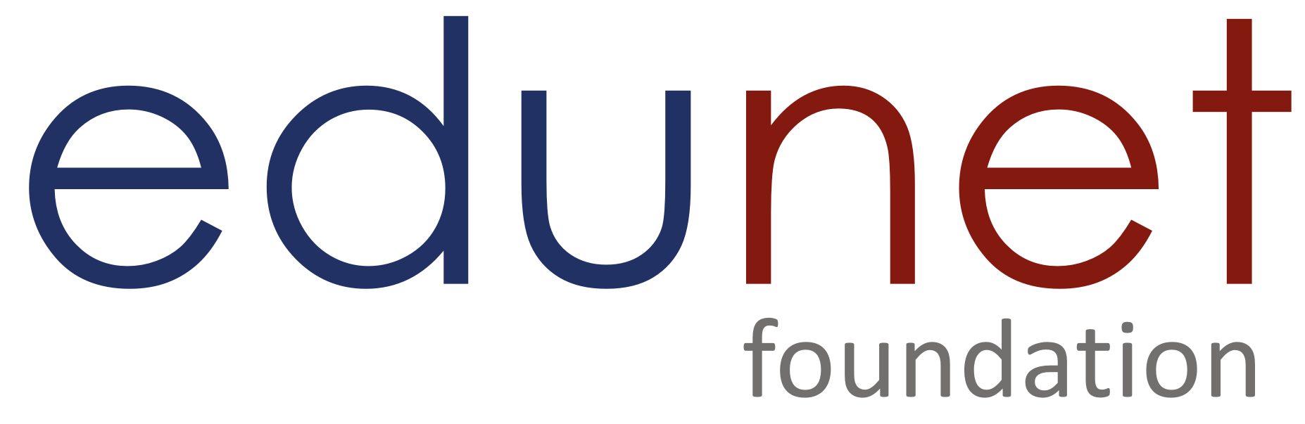
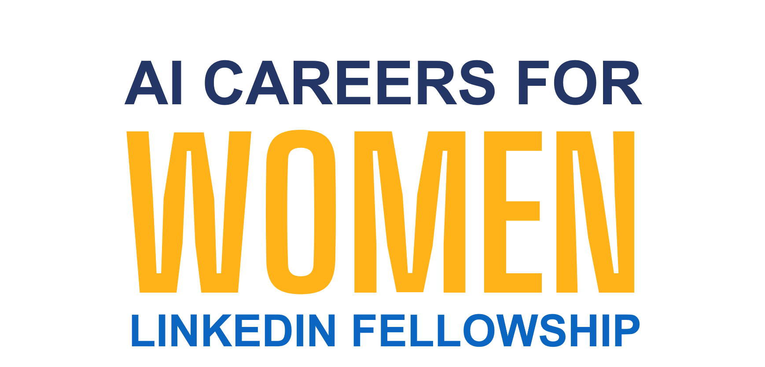


PRESENTATION 2026
The Willing But Wary Developers: AI Adoption, Trust Deficit, and Ethical Anxiety in software Engineering
The Willing but Wary Developer: AI Adoption, Trust Deficit, and Ethical Anxiety in Software Engineering
Mentor Name
Faculty Email
Chandniarora0007@gmail.com
Faculty Name
Umamaheswari R
Dr. Chandni Rani

Slide 2

Outline
Abstract of the Project
Problem Statement
Proposed Solution
System Architecture
Live Demo of the Project
Embedded Video of Project
Conclusion
Future Scope

Slide 3
Abstract
This project identifies the 'AI Trust Paradox’ phenomenon — a multi-dimensional construct manifesting across three interconnected dimensions:
Use-despite-distrust-where developers continue daily AI tool usage despite low trust in code accuracy.
The adoption-ethics gap- where positive sentiments coexists with deep skepticism about AI ethics.
The utility-threat tension- where developers acknowledge AI productivity benefits while simultaneously fearing job displacement.
By analyzing the Stack Overflow Developer Survey (N=48,195), we statistically proved the tension between the necessity of AI adoption and the critical distrust of its outputs.
Tools & Technologies: Excel + Python + Copilot+ Github
Expected outcomes: The outcomes include the empirical validation of the "AI Trust Paradox," statistically proving the stark disconnect between high AI adoption and low user trust.
Key Highlights: Statistically proves the massive decoupling of usage from trust, identifying a record-high 78.5% adoption rate alongside a critical 3.1% high trust rate.

Slide 4

Problem Statement
The Core Problem
Breakdown of the Technology Acceptance Model (TAM).
Trust is a prerequisite for adoption
In the modern developer workflow, we see a "Forced Adoption" model.
Developers are adopting AI without Trust
Significance & Challenge
Only 3.1% of developers highly trust AI, yet 78.5% use it daily.
This creates a high cognitive load known as "Verification Fatigue“
Who is Affected?
Individual Developers: Faced with anxiety regarding job security
Tech Managers: Struggling to balance team velocity with the risk of technical debt
Organizations: Investing heavily in AI licenses without understanding the psychological barriers preventing their engineers from fully relying on these tools.

Slide 5

Proposed Solution
To architect a comprehensive research framework that investigates the "AI Trust Paradox" by validating the systematic decoupling of high adoption rates from low professional trust among 48,195 global developers.
To design an interactive, zero-dependency dashboard that visualizes complex human-centric metrics—including Verification Fatigue and the Adoption-Ethics Gap—across diverse career stages and geographic regions.
To integrate a conversational AI agent that transforms dense statistical results into accessible, actionable insights, enabling stakeholders to navigate paradoxical findings through natural language interaction.
Methodology & Tools: Python (Scipy, Pandas, Numpy), Excel, HTML, Microsoft Copilot Studio

Slide 6
System Architecture
Data Input / Source
Processing / Analysis
Stack Overflow Developer Survey 2025 — survey_results_public.csv (49,191 × 172). Public. Licence: ODbL. Source: survey.stackoverflow.co/2025 · Kaggle.
Using Python 3.10 running on Google Colab; Advanced data cleaning using Pandas and NumPy libraries; Utilization of SciPy for Chi-square and Cramér's V tests
AI / Tool Integration
Output / Dashboard
Custom AI Agent built via Microsoft Copilot Studio
Interactive Dashboard: Single-file, zero-dependency HTML 4 pages (overview + 3 Paradox)
Cleaned excel dataset with schema
GitHub repository for version control, project documentation (final project report), and final deployment.

Slide 7
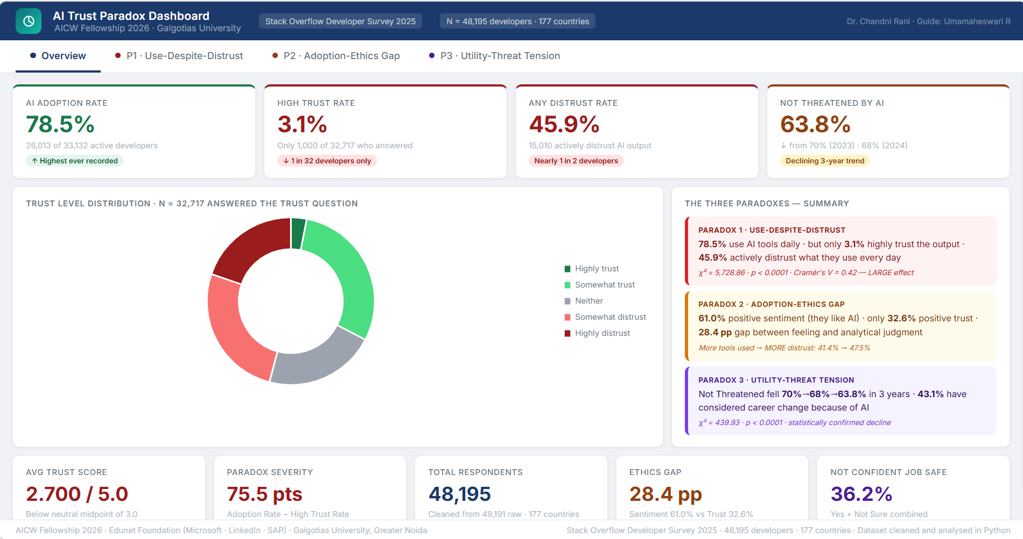
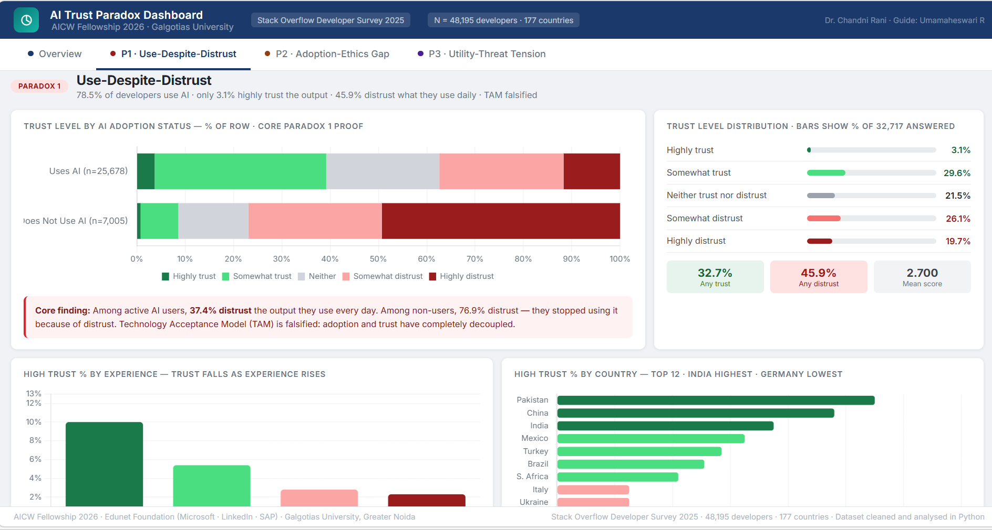
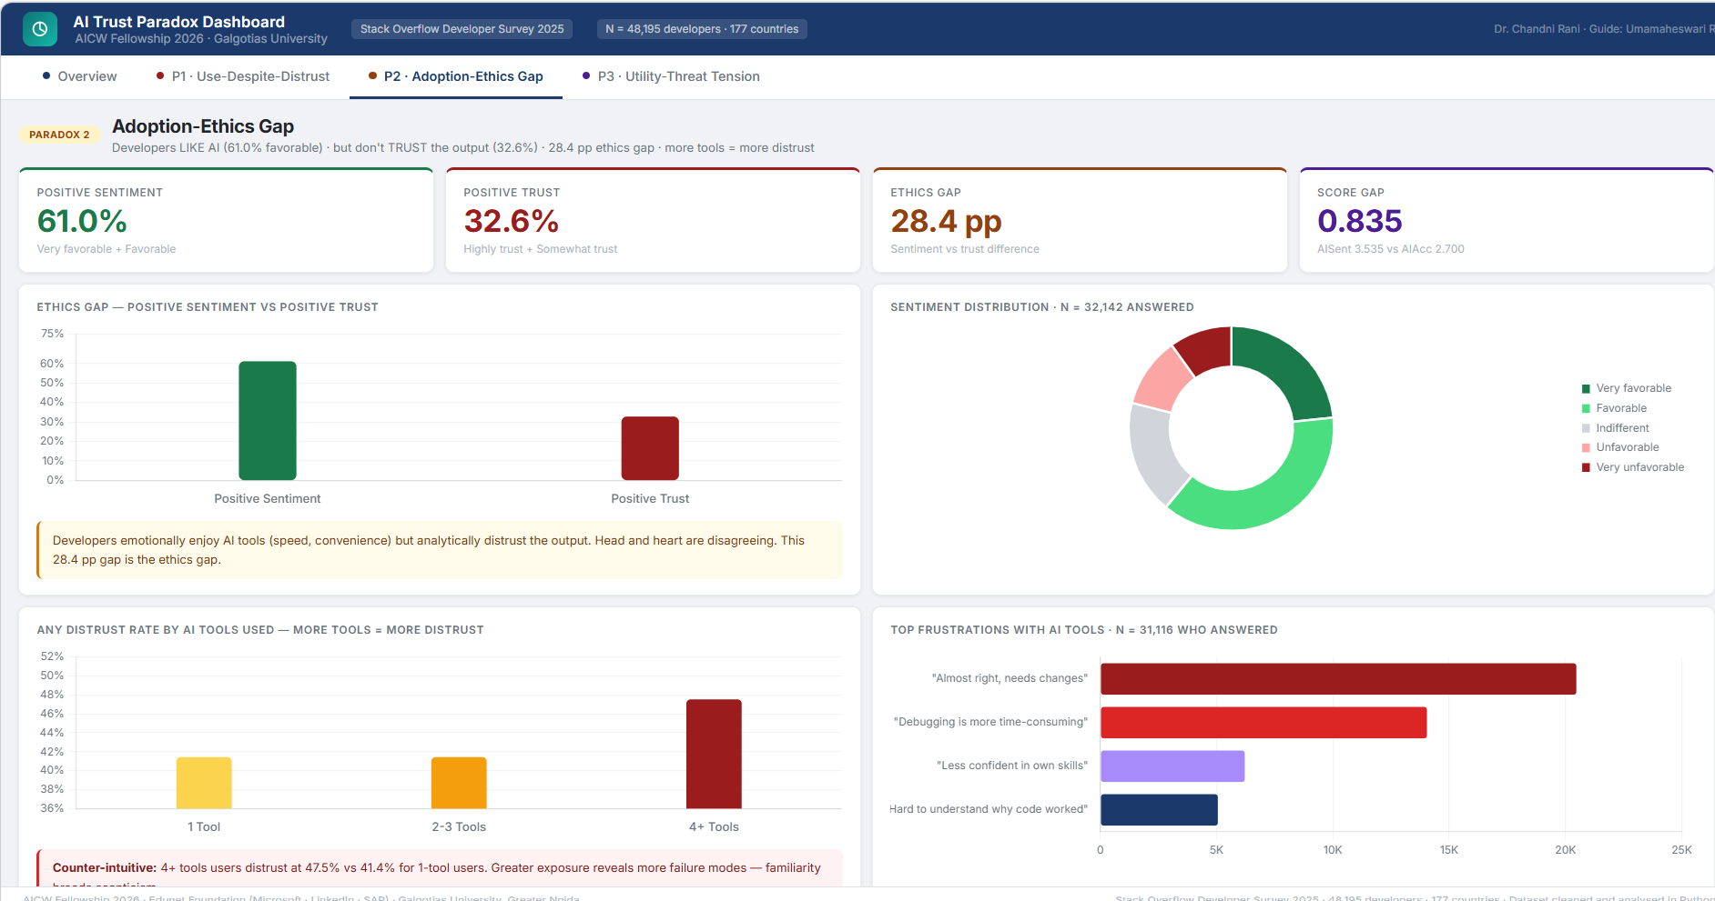
Live Demo of Project
Here's the list of some demo screenshots / features of the project:
Overview-This dashboard provides a high-level snapshot of the AI Trust Paradox, showing that while AI adoption is very high (78.5%), trust remains extremely low (3.1%) with significant distrust and ethical gaps.
Paradox1-Even active AI users exhibit significant distrust toward outputs, proving that usage and trust are decoupled. It highlights how distrust persists across user groups, experience levels, and geographies despite widespread adoption.
Paradox2-Adoption–Ethics Gap: This page reveals that while developers have strong positive sentiment toward AI (61%), their trust in its outputs is much lower (32.6%), creating a clear ethics gap.

Slide 8
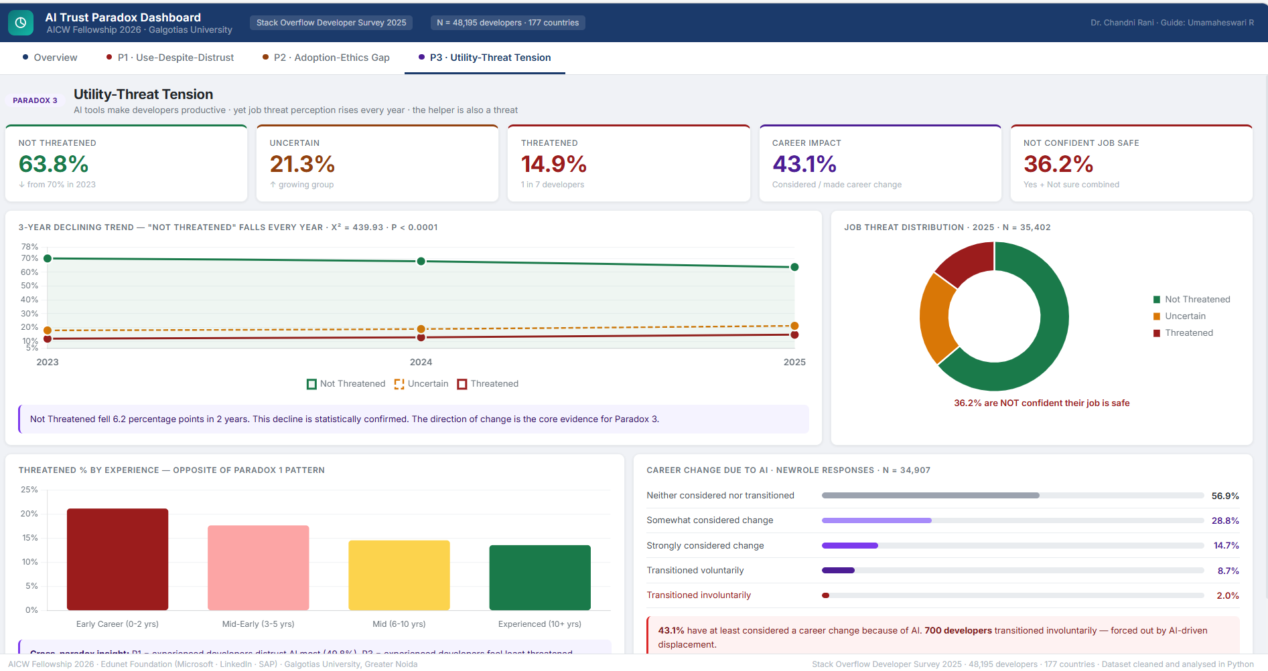
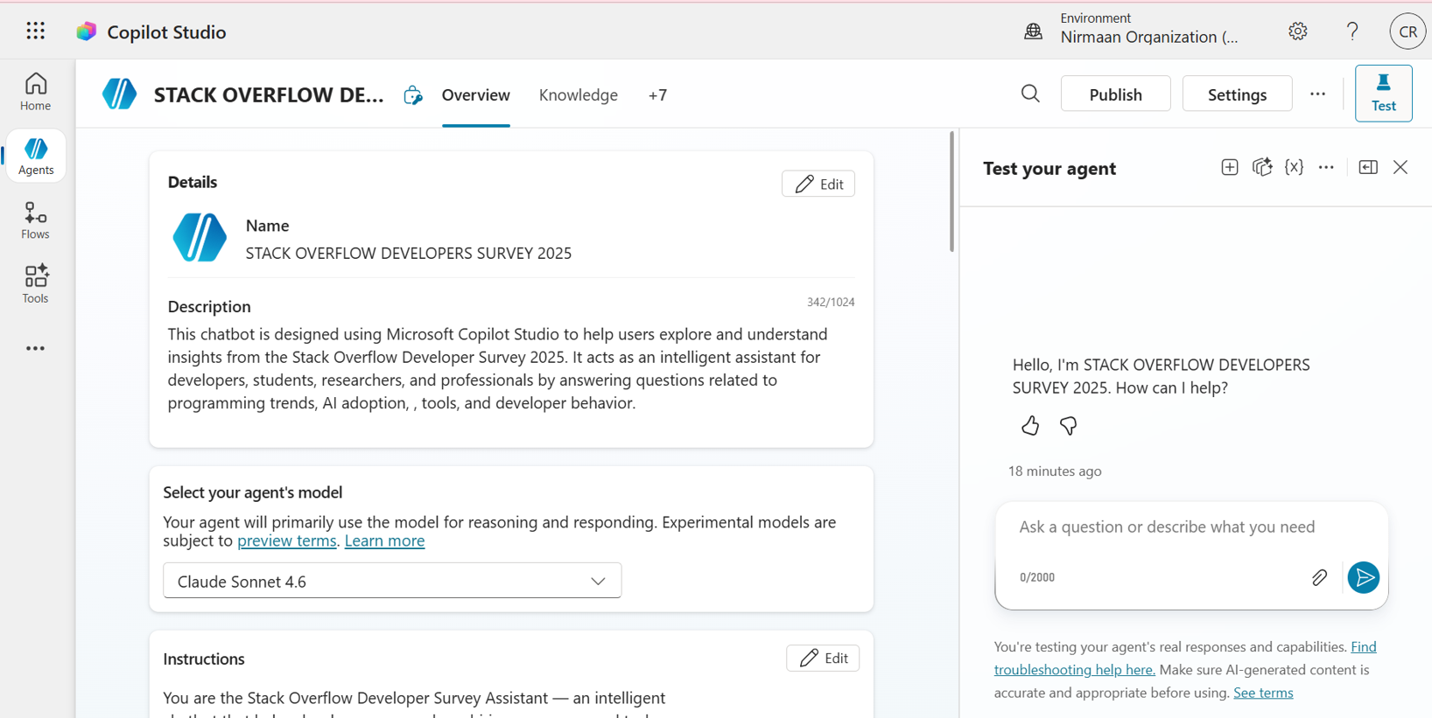
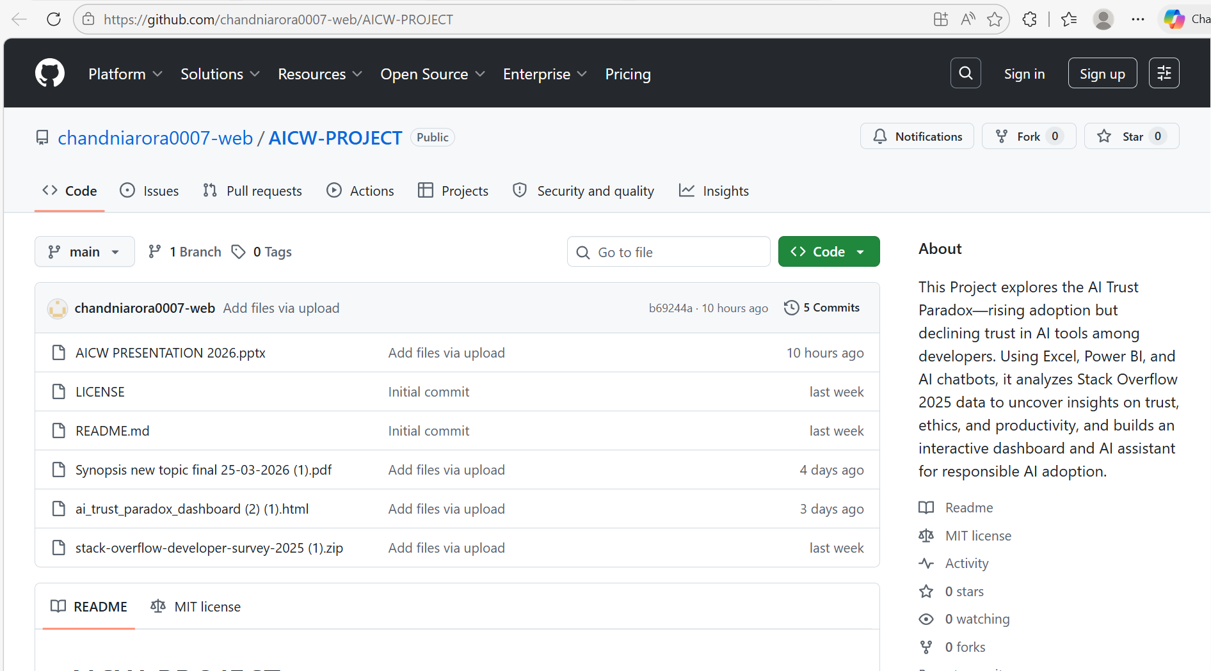
Live Demo of Project
Here's the list of some demo screenshots / features of the project:
Paradox 3-Utility–Threat Tension: This page shows that while AI improves productivity, perceived job threat is rising, with a declining share of developers feeling safe and many considering career changes. It highlights the growing tension where AI is both a helper and a potential threat to job security.
AI Chatbot-This setup showcases a tailored AI assistant built on the Stack Overflow Developer Survey 2025, designed to provide domain-specific insights on developer behavior, AI adoption, and trends through interactive, real-time querying.
AI Chatbot-This repository hosts the AI Trust Paradox project, including datasets, dashboards, reports. It serves as a centralized hub for exploring analysis, code, and outputs related to this project.

Slide 9
Video of Project Demo
[https://your-project-demo-link.com]
▶
[Insert your project demo video.
You can embed a video your live project.]

Slide 10
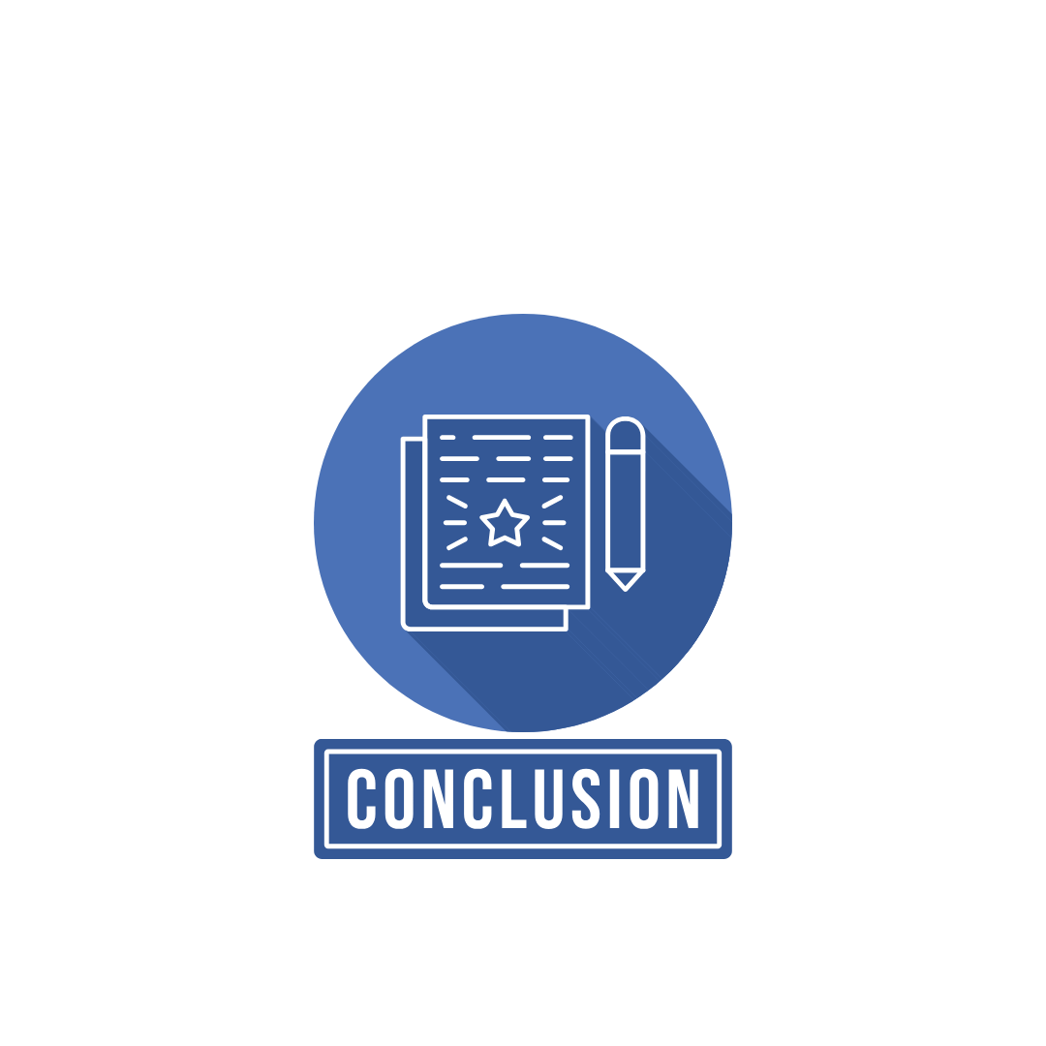
Conclusion
Key Results and Findings
Statistically proved that while 78.5% of developers use AI daily, only 3.1% maintain high trust in the output (chi^2 = 5,728.86, p < 0.0001).
Senior developers (10+ years) exhibit significantly higher "Verification Fatigue" than junior peers.
Found that developers using 4+ tools report a 47.5% distrust rate, proving that increased exposure to AI models highlights more failure modes.
A 28.4% sentiment gap exists where developers enjoy tool convenience but fundamentally doubt the underlying logic.
Overall Impact
Shifted the focus of AI evaluation from "Technical Benchmarks" to "Human-Centric Sentiment," identifying trust as the primary bottleneck for long-term
Demonstrated a "circular" use case of AI: using Generative AI tools to analyze and explain the very paradoxes they have created in the workforce.
Value Added to the Domain:
Provides organizations with a human-centric metric for AI success, moving beyond adoption numbers.
Offers a strategic blueprint for moving teams from "Forced Adoption"

Slide 11

Future Scope
Longitudinal Panel Study: Track the same developer cohort over three consecutive surveys to establish whether adoption drives distrust or vice versa via causal inference.
Structural Equation Modeling (SEM): Apply SEM to test the integrated TAM-CDT-JD-R model, confirming mediation and moderation paths (Expertise, Geography) simultaneously.
Qualitative Deep-Dive: Conduct 20–30 in-depth interviews to understand the "lived experience" of the paradox and how developers rationalize daily use despite professional scepticism.
Real-Time Monitoring Ecosystem: Deploy a Power Automate pipeline to auto-refresh the analytical dashboard as future survey datasets are released.

Slide 12
Thank You
AICW Fellowship | Faculty Project Presentation 2026
LinkedIn | Edunet Foundation

